Slide 1
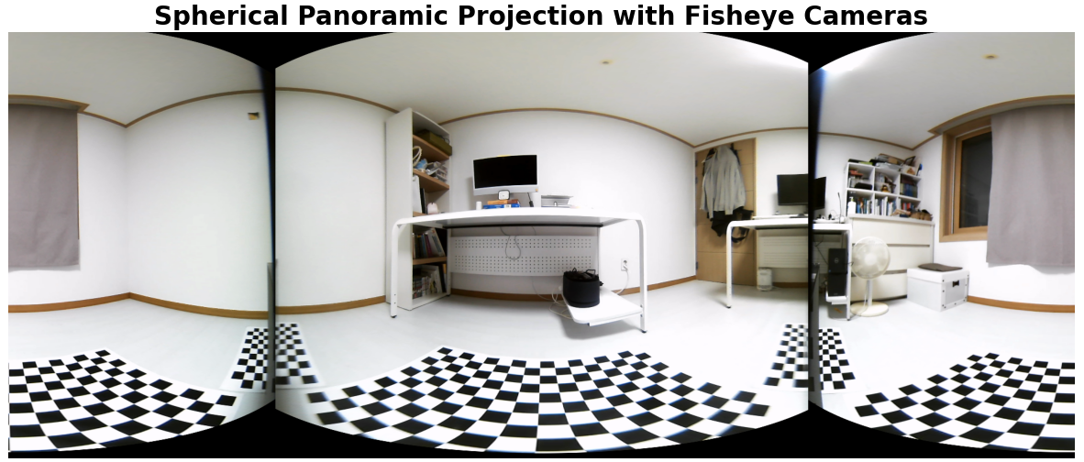
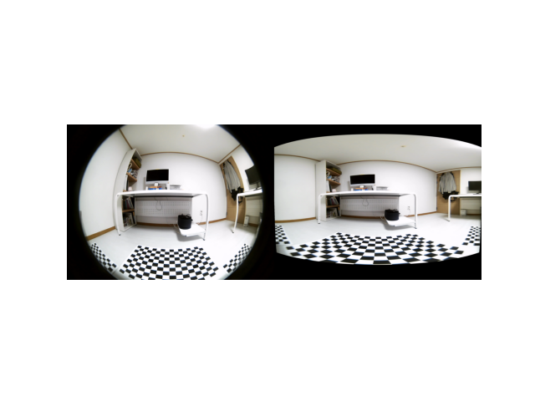
원본 이미지
구면 투영 이미지

Slide 2
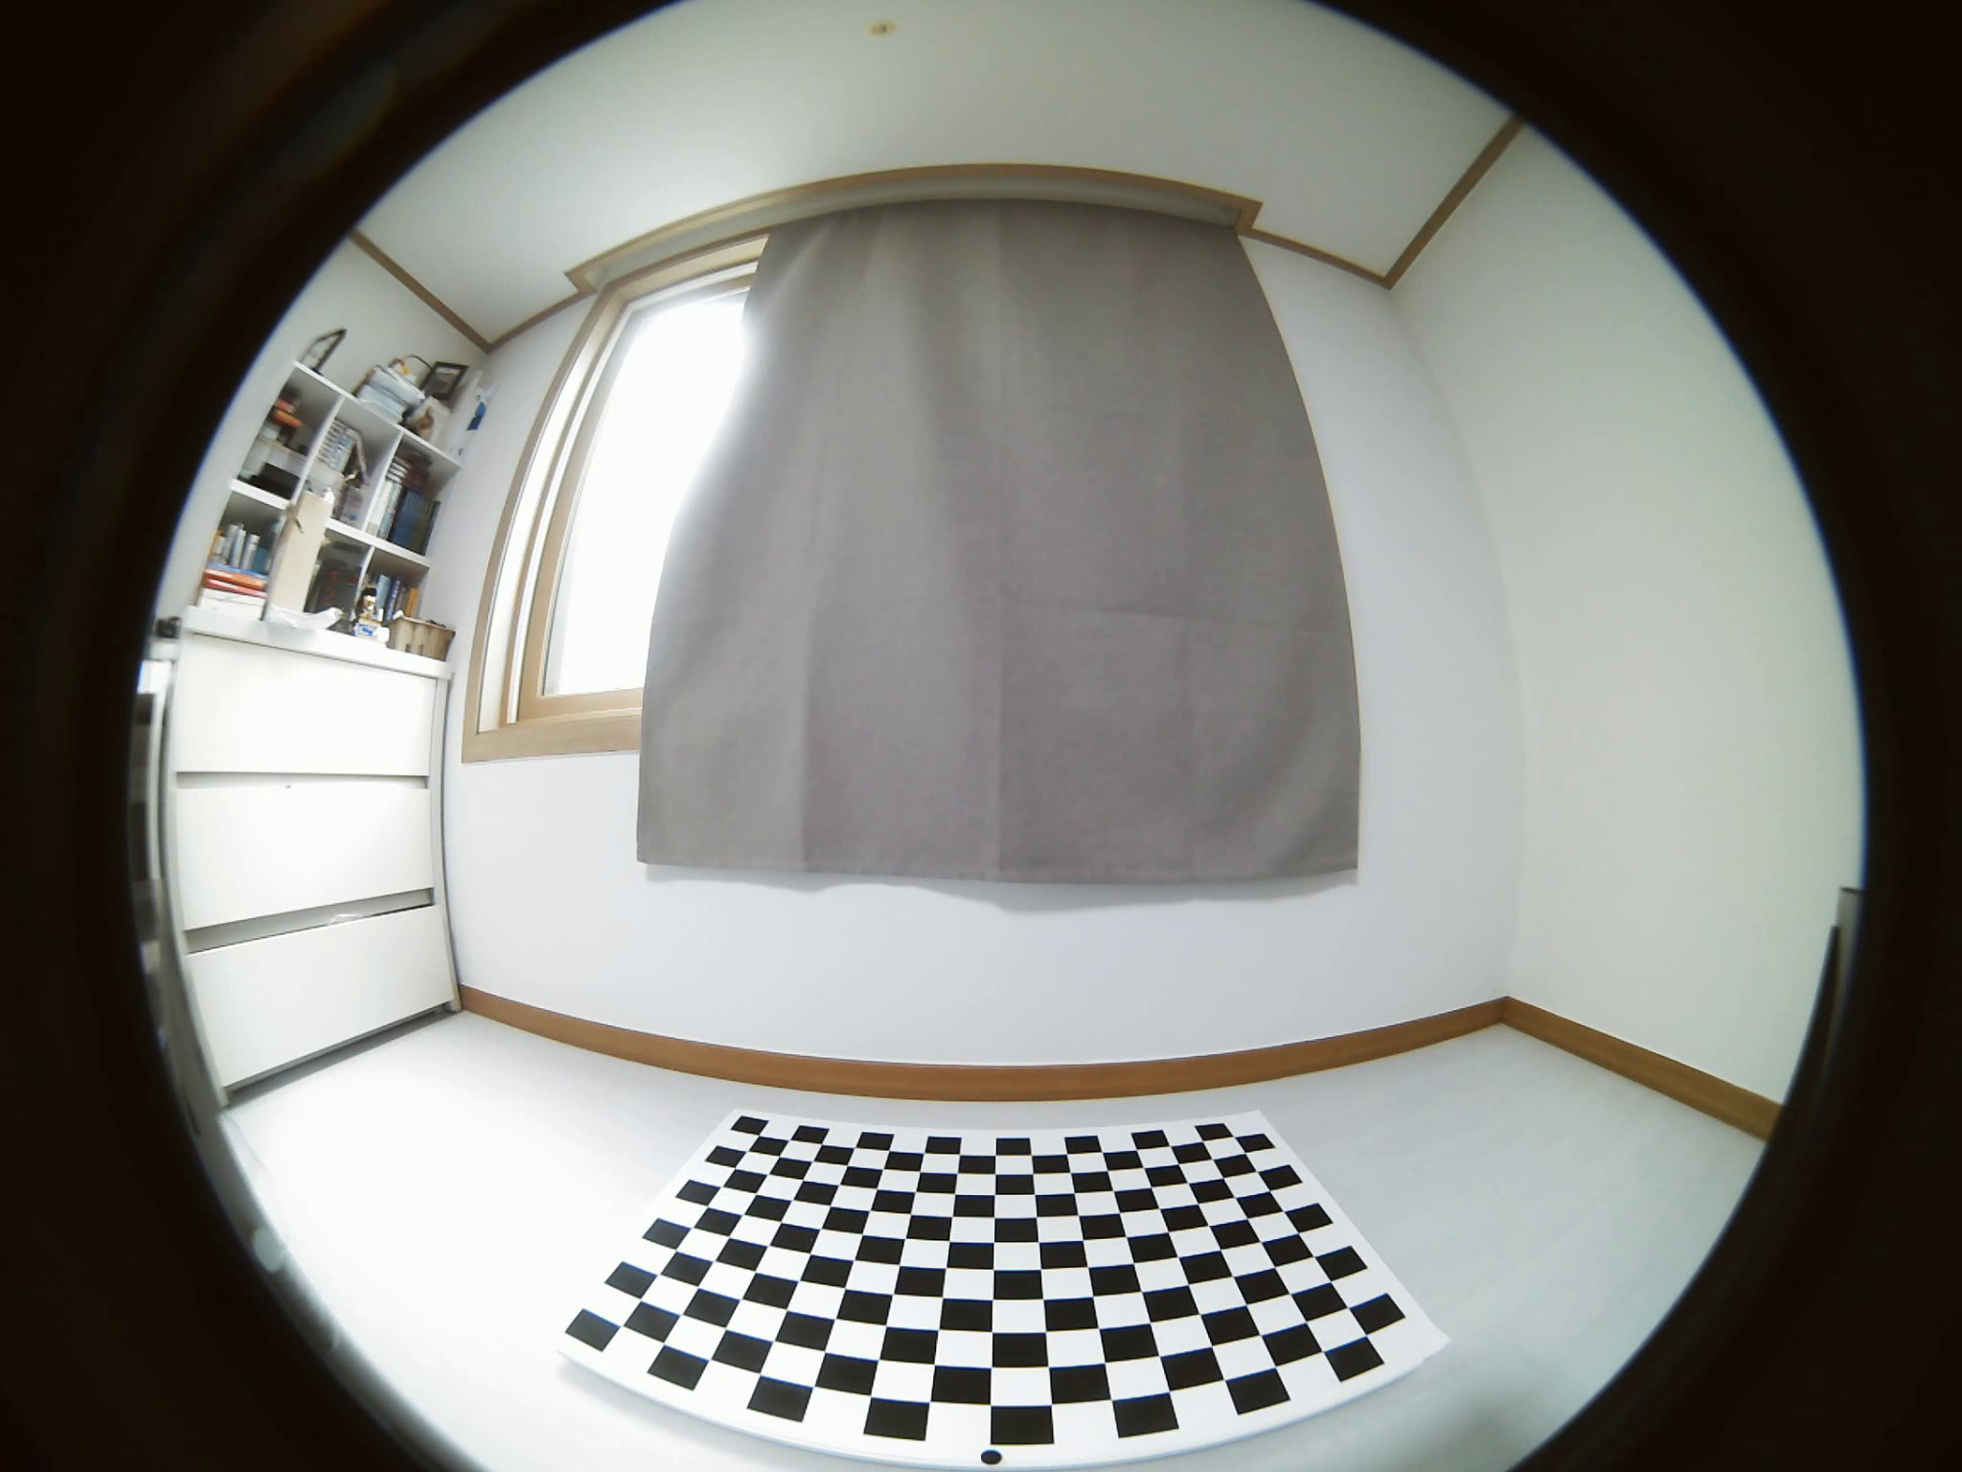
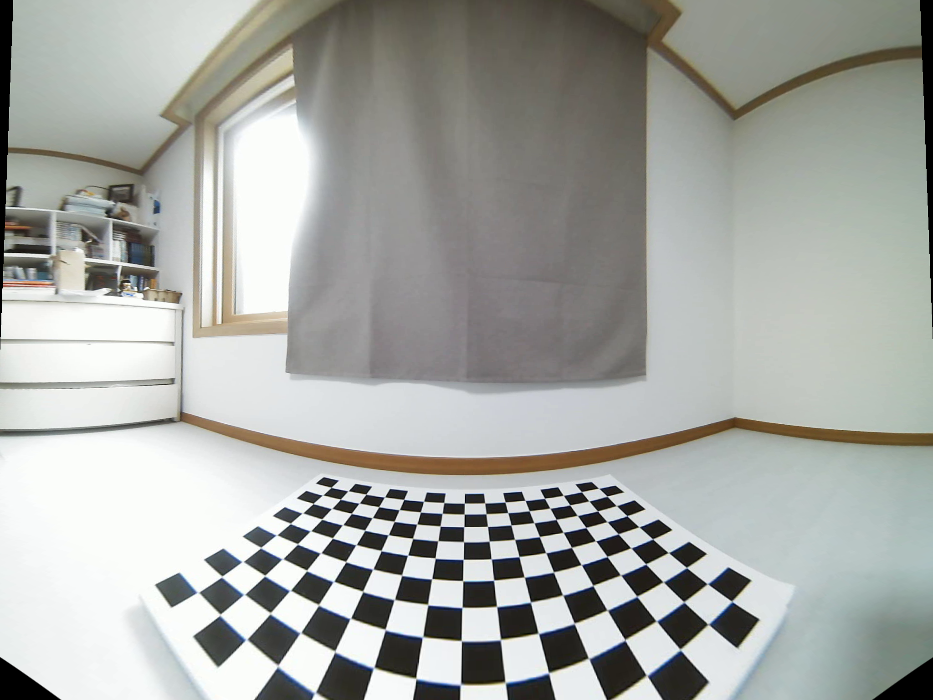
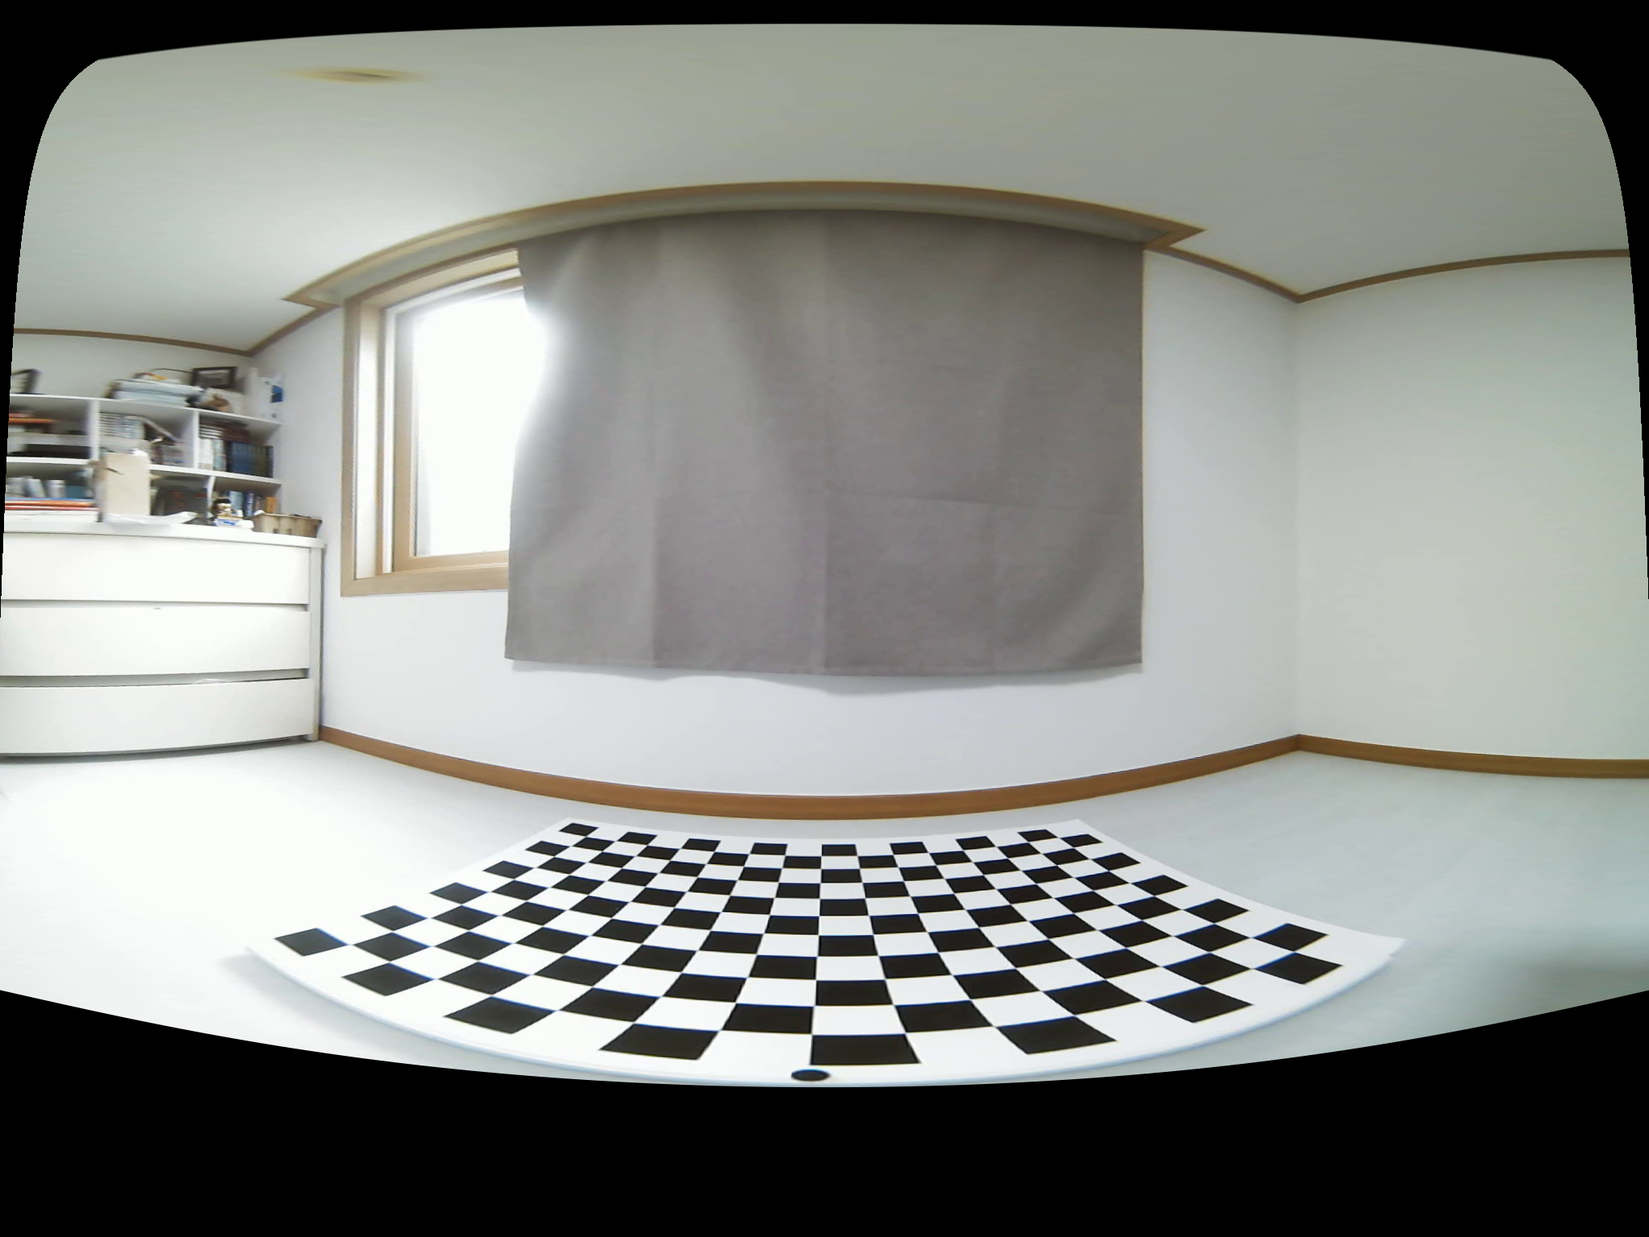
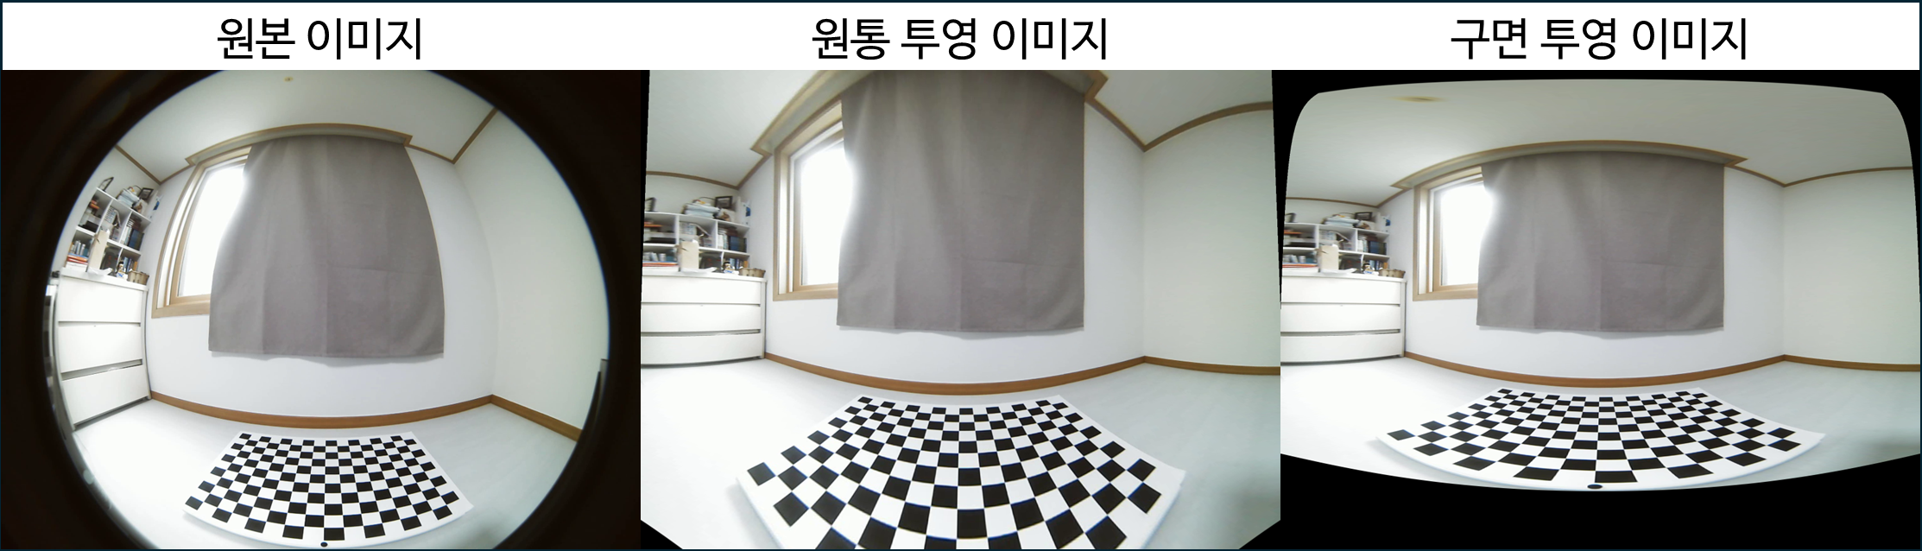
원본 이미지
원통 투영 이미지
구면 투영 이미지

Slide 4






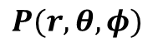



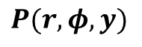
원통 좌표계
구면 좌표계
직교 좌표계
원통 좌표계
Z
Z
Roll
Roll
Z
Z
Roll
Roll
$$φ$$
$$φ$$
$$r$$
X
X
$$ϕ$$
Pitch
$$θ$$
Pitch
X
$$r$$
X
$$r$$
Pitch
Pitch
$$P(r, φ, y)$$
$$P(r, θ, φ)$$
$$P(x, y, z)$$
$$P(r, φ, y)$$
Y
Yaw
Y
Yaw
Y
Yaw
Y
Yaw
Z
Roll
Z
Z
Z
Roll
Cam X
Roll
Roll
Cam Z
원통 좌표계
X
X
X
X
Pitch
Cam X
Pitch
Pitch
Pitch
Cam Z
Cam X
Cam Y
Cam Z
Y
Yaw
Cam Y
Y
Yaw
Y
Yaw
Cam Y
Y
Yaw

Slide 5

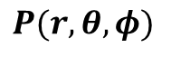





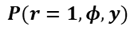
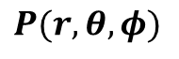


- 이미지의 중점 = XY 좌표축의 중점
- $\left(u, v\right)→(φ, y)$
이미지의 중점 = XY 좌표축의 중점
$\left(u, v\right)→(φ, θ)$
이미지의 중점 = XY 좌표축의 중점
$\left(u, v\right)→(φ, θ)$
Z
Roll
Z
Z
$$φ$$
Roll
Roll
$$r$$
X
$$φ$$
$$φ$$
Pitch
X
$$P(r=1, φ, y)$$
$$θ$$
Pitch
$$θ$$
$$r$$
X
$$P(r, θ, φ)$$
$$r$$
Y
Yaw
Pitch
$$P(r, θ, φ)$$
Y
Yaw
Y
Yaw

Slide 6
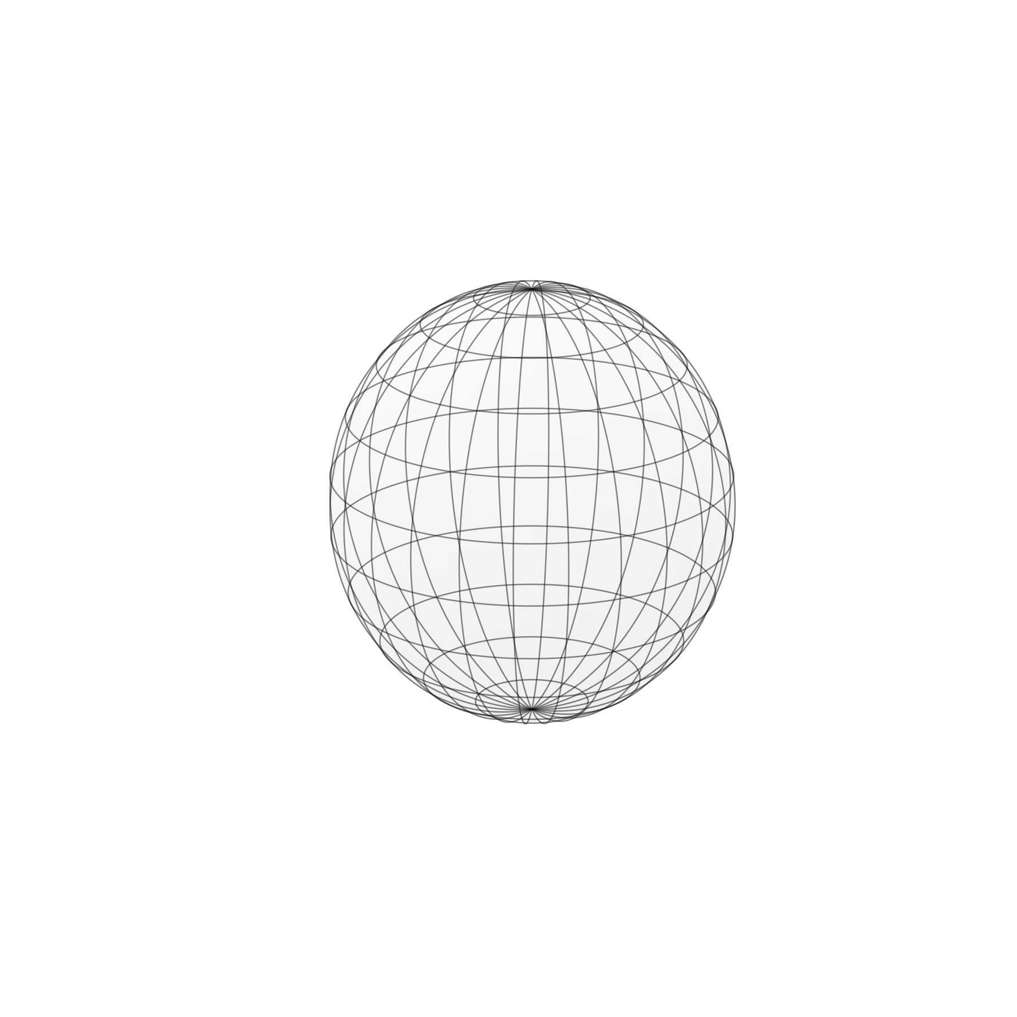
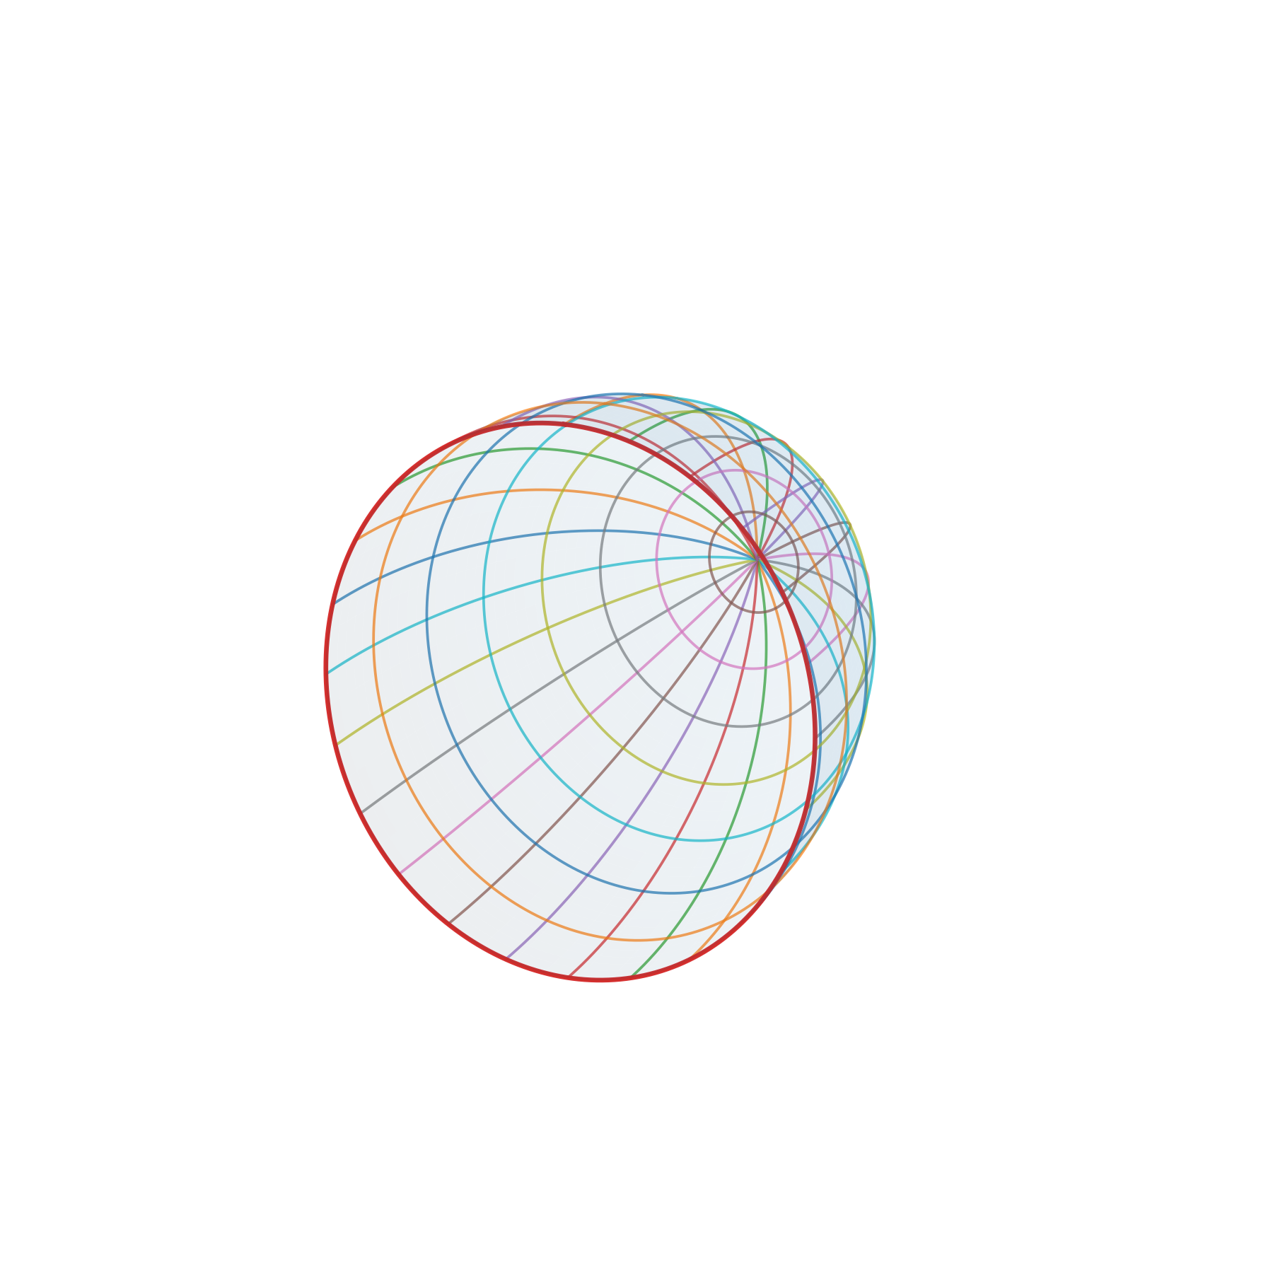
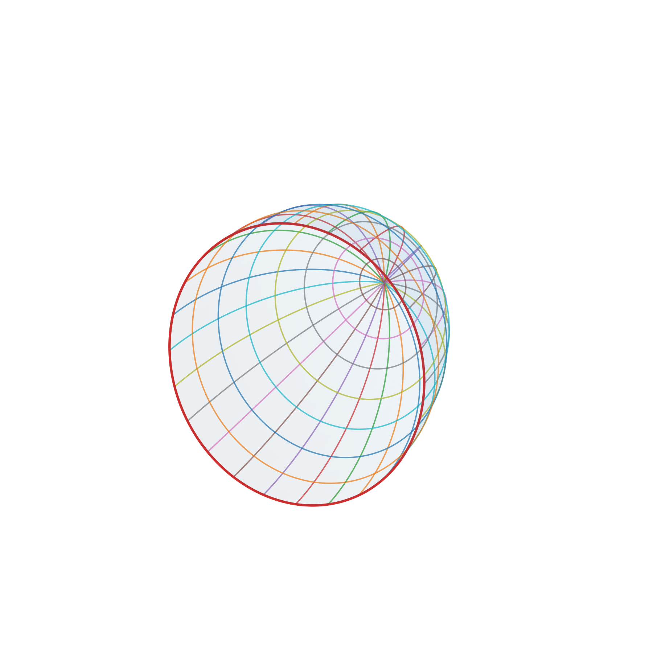



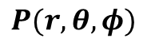
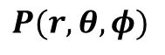


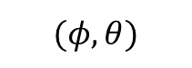


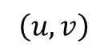
Z
이미지의 중점 = XY 좌표축의 중점
$\left(u, v\right)→(φ, θ)$
Roll
$$φ$$
$$θ$$
$$r$$
X
Pitch
Z
$$P(r, θ, φ)$$
Z
Y
Yaw
$$\left(u, v\right)$$
$$(φ, θ)$$
Roll
$$φ$$
$$θ$$
X
$$r$$
X
Pitch
$$P(r, θ, φ)$$
Y
Y
Yaw
카메라 중심축으로 표현한 이미지
카메라 중심축으로 표현한 구면

Slide 7
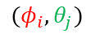
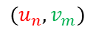
image width
horizontal fov (hfov) = image width
w
w'
vertical fov (vfov)
image height
image height
h
$$(u_{n}, v_{m})$$
h'
$$(φ_{i}, θ_{j})$$
원본 이미지
구면 투영 이미지

Slide 8
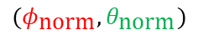
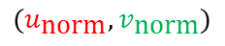
image width
horizontal fov (hfov)
X
vertical fov (vfov)
X
image height
Pitch
Y
$$(u_{\text{norm}}, v_{\text{norm}})$$
$$(φ_{\text{norm}}, θ_{\text{norm}})$$
Y
Yaw
normalized 이미지 좌표계 (직교 좌표계)
normalized 이미지 좌표계 (구면 좌표계)

Slide 9
horizontal fov (hfov)
horizontal fov (hfov) = image width
w'
X
vertical fov (vfov)
image height
vertical fov (vfov)
Pitch
$$(φ_{\text{norm}}, θ_{\text{norm}})$$
h'
$$(φ_{i}, θ_{j})$$
Y
Yaw
normalized 이미지 좌표계 (구면 좌표계)
구면 투영 이미지

Slide 10









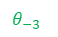


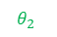












horizontal fov (hfov)
X
$$θ_{−4}$$
$$θ_{−3}$$
Pitch
$$θ_{−2}$$
vertical fov (vfov)
$$θ_{−1}$$
$$θ_{0}$$
$$θ_{1}$$
$$θ_{2}$$
$$θ_{3}$$
$$θ_{4}$$
$$φ_{−7}$$
$$φ_{−6}$$
$$φ_{−5}$$
$$φ_{−4}$$
$$φ_{−3}$$
$$φ_{−2}$$
$$φ_{−1}$$
$$φ_{0}$$
$$φ_{1}$$
$$φ_{2}$$
$$φ_{3}$$
$$φ_{4}$$
$$φ_{5}$$
$$φ_{6}$$
$$φ_{7}$$
Y
Yaw
ex) $\left(φ_{4}, θ_{2}\right) 는 (u_{n}, v_{m})$ 과 대응이 됨
구면 투영을 위한 Look Up Table

Slide 11



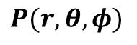
horizontal fov (hfov)
Z
Roll
vertical fov (vfov)
X
$$φ$$
Pitch
$$θ$$
$$r$$
Z
Roll
$$P(r, θ, φ)$$
Y
Yaw
$$φ$$
X
$$θ$$
Pitch
$$r$$
$$P(r, θ, φ)$$
Y
Yaw

Slide 12
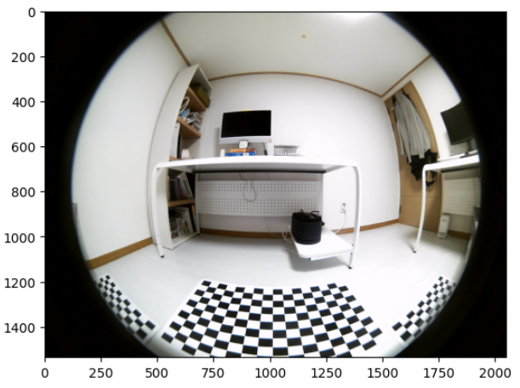
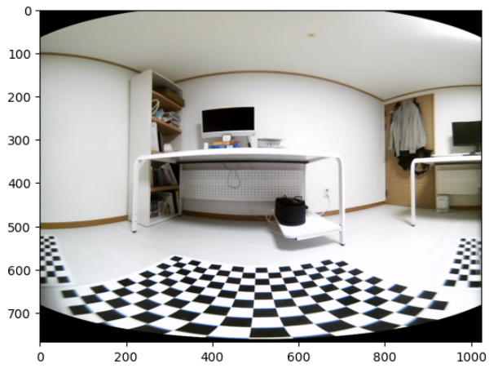

Slide 13
#512
#512
#384
X
Z
Y
#384

Slide 14
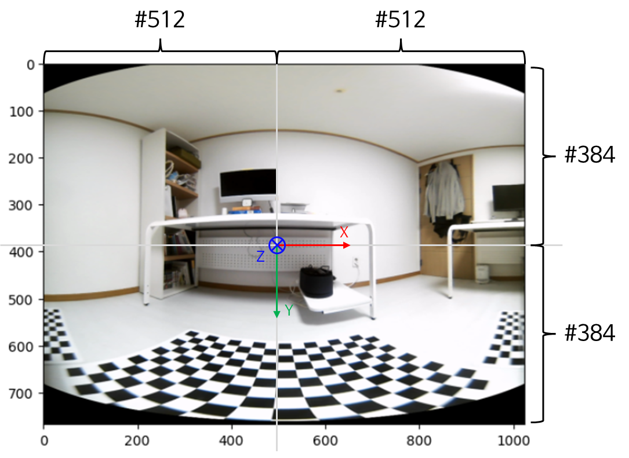
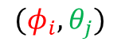

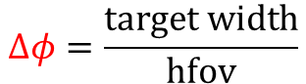
horizontal fov (hfov)
vertical fov (vfov)
X
Pitch
$$(φ_{i}, θ_{j})$$
Y
Yaw
$$Δφ=\frac{\text{target} \text{width}}{\text{hfov}}$$
$$Δθ=\frac{\text{target} \text{height}}{\text{vfov}}$$

Slide 15
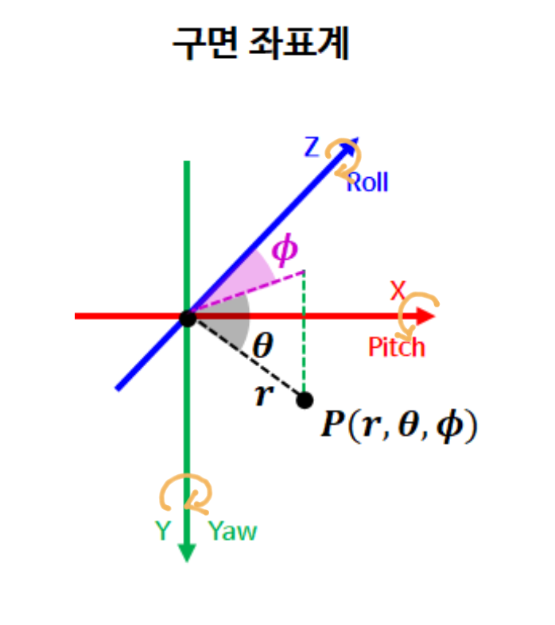
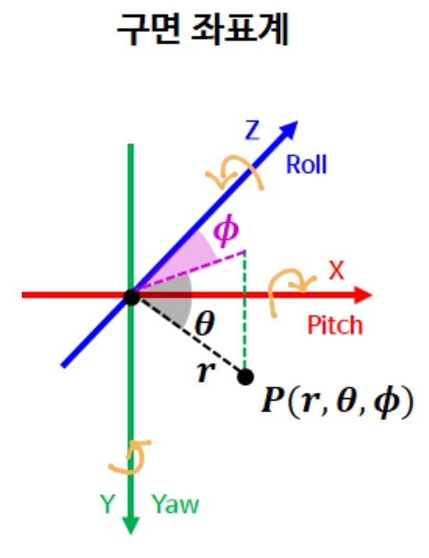
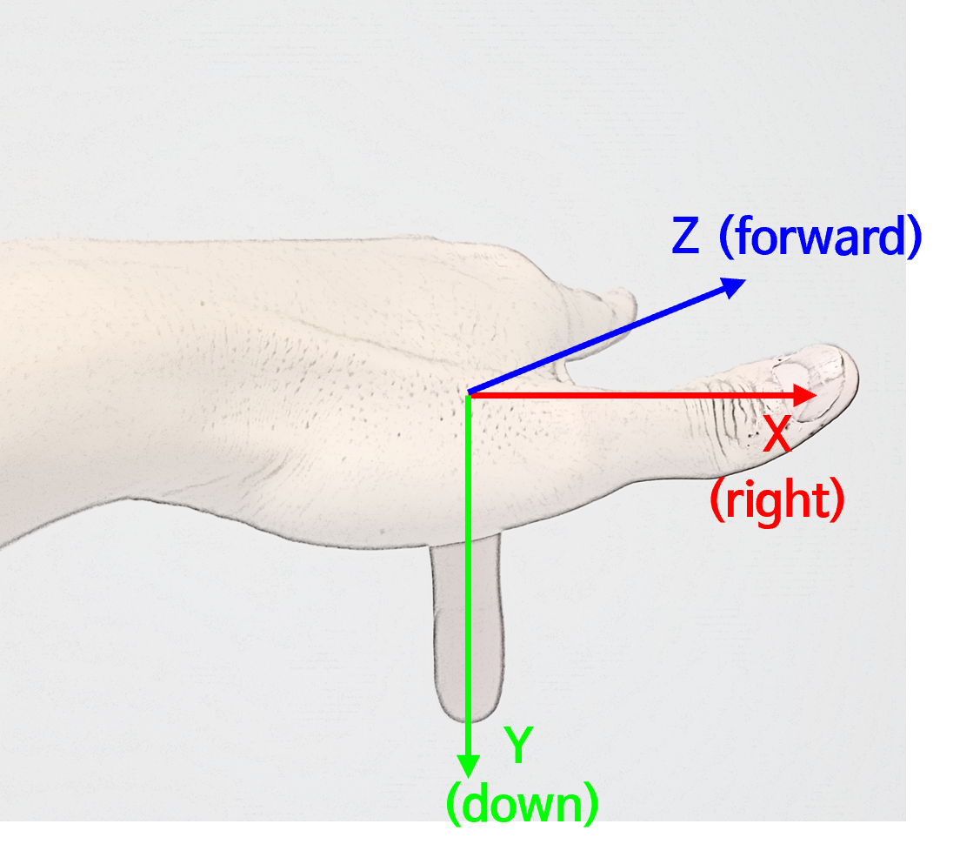

RDF 좌표계 손가락 표시
구면 좌표계
시계 방향
반시계 방향
반시계 방향
시계 방향
구면 좌표계
Z
반시계 방향
Roll
시계 방향
$$x_{c}$$
$$φ$$
ⓑ
X
$$θ$$
ⓐ
Pitch
$$r$$
$$P(r, θ, φ)$$
Y
Yaw

Slide 16
구면 좌표계
회전 반영 이전
Pitch +30 deg 회전
반시계 방향
반시계 방향
Z
Z
X
Roll
Roll
X
Roll
Roll
반시계 방향
Y
Yaw
Y
Yaw

Slide 17
구면 좌표계
회전 반영 이전
Yaw +30 deg 회전
반시계 방향
반시계 방향
X
X
Y
Yaw
Pitch
Y
Yaw
Pitch
반시계 방향
Z
Roll
Z
Roll

Slide 18
구면 좌표계
회전 반영 이전
Roll +30 deg 회전
반시계 방향
반시계 방향
X
X
Z
Roll
Z
Pitch
Roll
Pitch
반시계 방향
Y
Yaw
Y
Yaw

Slide 19

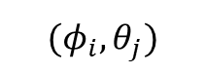
horizontal fov (hfov)
Z
$$(φ_{i}, θ_{j})$$
$$φ$$
vertical fov (vfov)
X
$$θ$$
Pitch
X
$$r$$
Pitch
$$P(r, θ, φ)$$
Y
Yaw
Y
Yaw

Slide 20
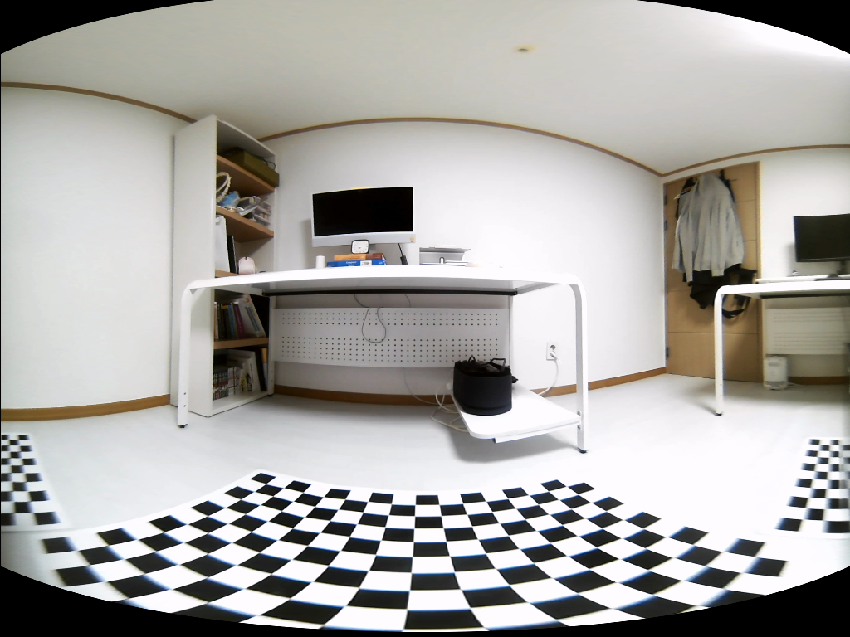
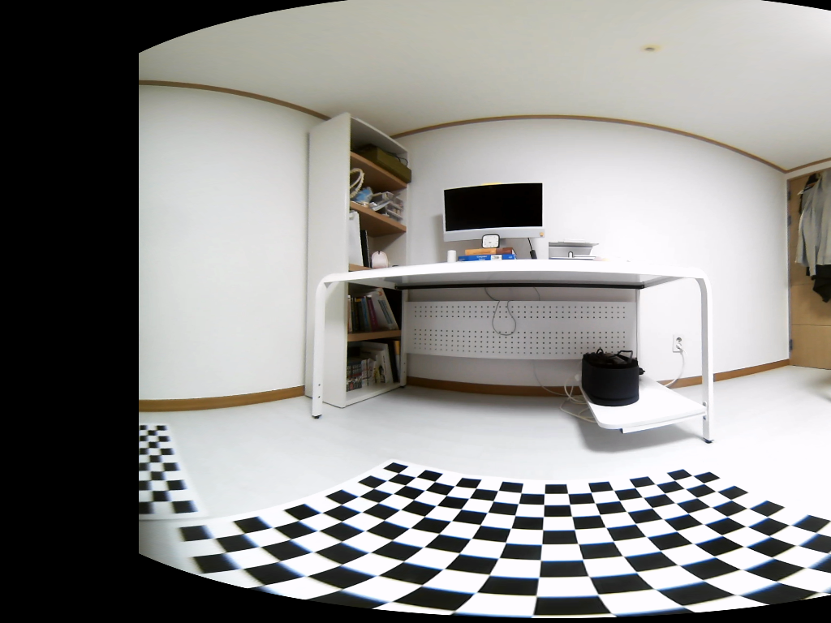
회전 반영 이전
Yaw +30 deg 회전 반영

Slide 21
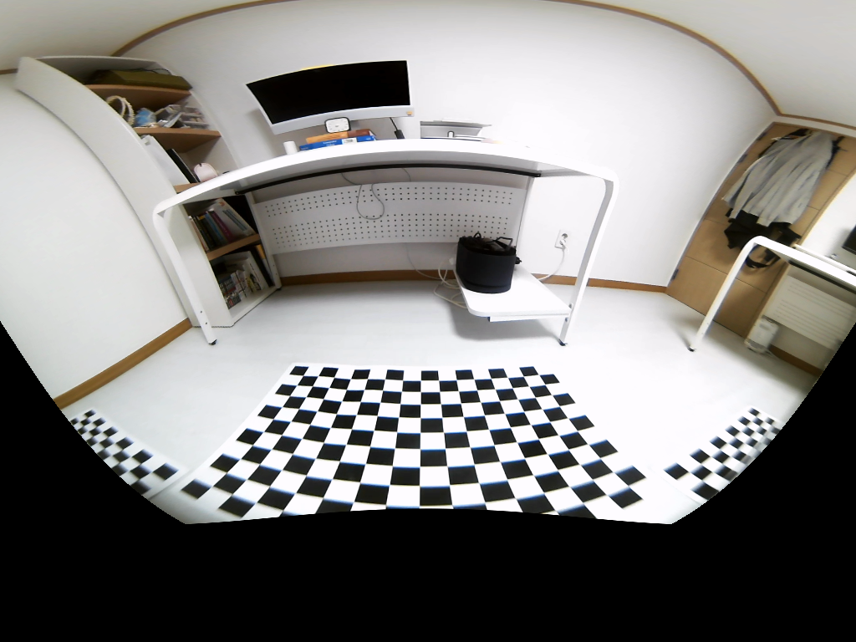
회전 반영 이전
Pitch +30 deg 회전 반영

Slide 22
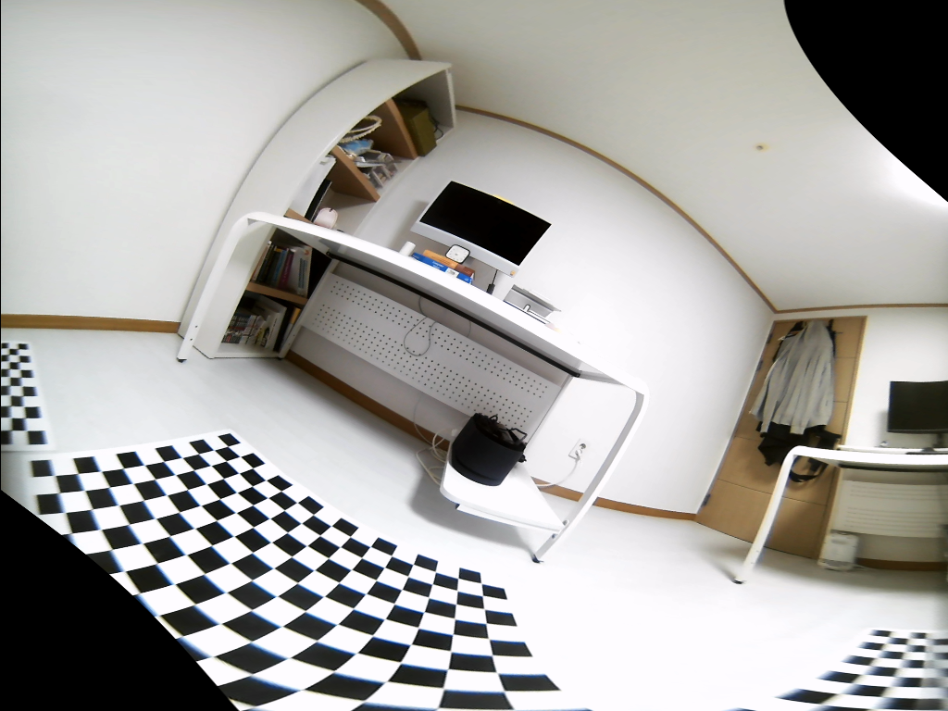
회전 반영 이전
Roll +30 deg 회전 반영

Slide 23

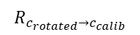




$$Z_{c_{calib}}$$
$$R_{c_{rotated}→c_{calib}}$$
$$R_{c_{rotated}→w}$$
$$Z_{w}$$
③
②
$$R_{w→c_{calib} }$$
$$Z_{c_{rotated}}$$
①

Slide 24
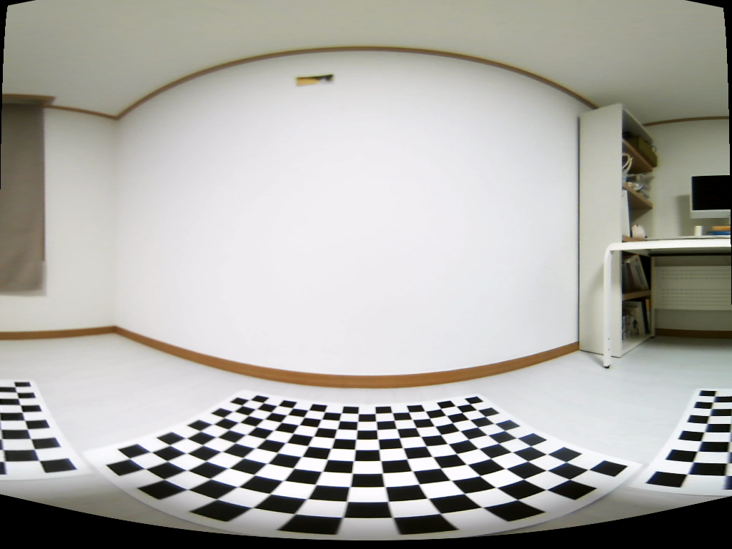
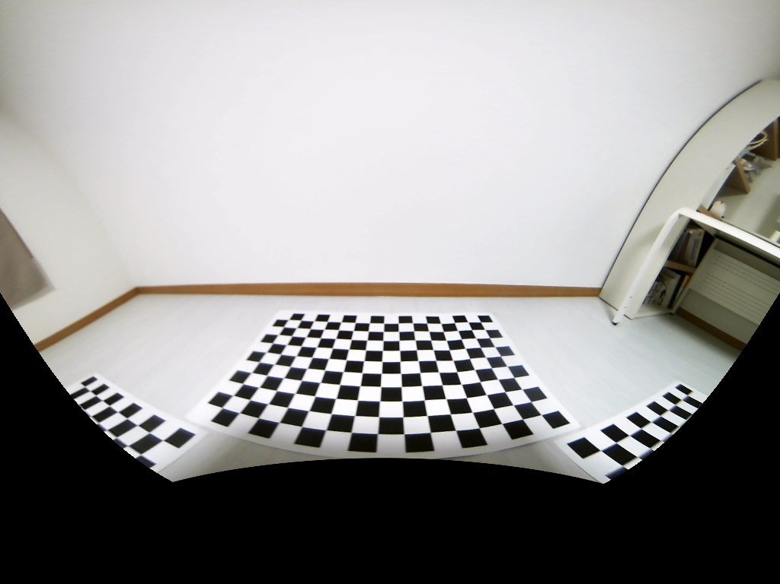
left fisheye camera
roll: 0, pitch:0, yaw: 90
roll: 0, pitch:30, yaw: 90

Slide 25
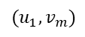
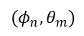

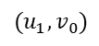

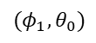
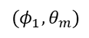
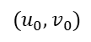

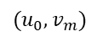
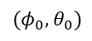

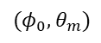





Backward Mapping
Source
Target
$$(u_{0}, v_{0})$$
$$(φ_{0}, θ_{0})$$
$$…$$
$$…$$
$$(u_{0}, v_{m})$$
$$(φ_{0}, θ_{m})$$
$$(u_{1}, v_{0})$$
$$(φ_{1}, θ_{0})$$
$$…$$
$$…$$
$$(u_{1}, v_{m})$$
$$(φ_{1}, θ_{m})$$
$$…$$
$$…$$
$$(u_{n}, v_{0})$$
$$(φ_{n}, θ_{0})$$
$$…$$
$$…$$
$$(u_{n}, v_{m})$$
$$(φ_{n}, θ_{m})$$

Slide 26

②
①
⑫
③
원점
⑪
front
④
left
right
⑩
rear
⑤
⑨
⑥
⑦
⑧

Slide 27








샘플 1
샘플 2
Roll:0, Pitch:0, Yaw: 0
Roll:20, Pitch:10, Yaw: 30
Front
Fisheye Camera
Roll:0, Pitch:0, Yaw: 90
Roll:20, Pitch:10, Yaw: 120
Left
Fisheye Camera
Roll:0, Pitch:0, Yaw: 180
Roll:10, Pitch:20, Yaw: 150
Rear
Fisheye Camera
Roll:0, Pitch:0, Yaw: 270
Roll:30, Pitch:20, Yaw: 240
Right
Fisheye Camera

Slide 28








Front Fisheye Camera
Roll:0, Pitch:0, Yaw: 0
Front Fisheye Camera
Roll: 30, Pitch: 20, Yaw: 30
$$\left(φ_{\text{coord} }, θ_{\text{coord}}\right)=\left(372, 460\right)→P_{w}=\text{(0.3, 0.4, 0)}$$
$$\left(φ_{\text{coord} }, θ_{\text{coord}}\right)=\left(240, 610\right)→P_{w}=\text{(0.3, 0.4, 0)}$$
Left Fisheye Camera
Roll:0, Pitch:0, Yaw: 90
Left Fisheye Camera
Roll:20, Pitch:30, Yaw: 70
$$\left(φ_{\text{coord} }, θ_{\text{coord}}\right)=\left(545, 465\right)→P_{w}=\text{(0.}\text{0}\text{, 0.}\text{75}\text{, 0}\text{.0}\text{)}$$
$$\left(φ_{\text{coord} }, θ_{\text{coord}}\right)=\left(708, 600\right)→P_{w}=\text{(0.}\text{0}\text{, 0.}\text{75}\text{, 0}\text{.0}\text{)}$$
Rear Fisheye Camera
Roll:0, Pitch:0, Yaw: 180
Rear Fisheye Camera
Roll: -30, Pitch: 40, Yaw: 180
$$\left(φ_{\text{coord} }, θ_{\text{coord}}\right)=\left(275, 670\right)→P_{w}=\text{(}\text{−0.9}\text{, }\text{−0.25}\text{, 0}\text{.0}\text{)}$$
$$\left(φ_{\text{coord} }, θ_{\text{coord}}\right)=\left(459, 539\right)→P_{w}=\text{(}\text{−0.9}\text{, }\text{−0.25}\text{, 0}\text{.0}\text{)}$$
Rear Fisheye Camera
Roll:0, Pitch:0, Yaw: 270
Rear Fisheye Camera
Roll: -40, Pitch: -20, Yaw: 300
$$\left(φ_{\text{coord} }, θ_{\text{coord}}\right)=\left(481, 638\right)→P_{w}=\text{(}\text{−0.3}\text{, }\text{−0.75}\text{, 0}\text{.0}\text{)}$$
$$\left(φ_{\text{coord} }, θ_{\text{coord}}\right)=\left(900, 548\right)→P_{w}=\text{(}\text{−0.3}\text{, }\text{−0.75}\text{, 0}\text{.0}\text{)}$$

Slide 29




Yaw = from calibration
Yaw = from calibration
Yaw = from calibration
Yaw = from calibration
Vanishing Line
Roll = 0, Pitch = 0

Slide 30




Z
Z
X
X
Z
X
Y
Y
Y

Slide 31
원점
front
left
right
rear

Slide 32

180 deg
90 deg
0 deg
270 (-90) deg
180 deg

Slide 33
원점
front
left
right
rear

Slide 34

180 deg
90 deg
0 deg
270 (-90) deg
180 deg

Slide 35




Slide 36


Topview with Fisheye Front/Rear Camera
Topview with Fisheye Left/Right Camera

